Slide 1
Introduction to Frontend
Course Code: CSC 4182
Course Title: Advanced Programming In Web Technologies
Dept. of Computer Science
Faculty of Science and Technology
Lecture No: | 1 | Week No: | 08 | Semester:
Lecturer: | Sazzad Hossain; sazzad@aiub.edu

Slide 2
Lecture Outline
What is frontend
How Web Works
CSS Frameworks, Libraries, and Preprocessors
JavaScript libraries and frameworks
What is DOM?
Rendering User Interfaces

Slide 3
WHAT IS FRONTEND
Frontend: client-facing part of a web app or in browser
Built using HTML, CSS, and JavaScript
Responsible for rendering UI and enabling user interaction
Runs in user's web browser
Communicates with backend running on a server
Sends requests to backend, which processes and sends back responses
Can be divided into three main components:
HTML: structure the content of the web page
CSS: style the page and make it visually appealing
JavaScript: add interactivity and functionality to the page

Slide 4
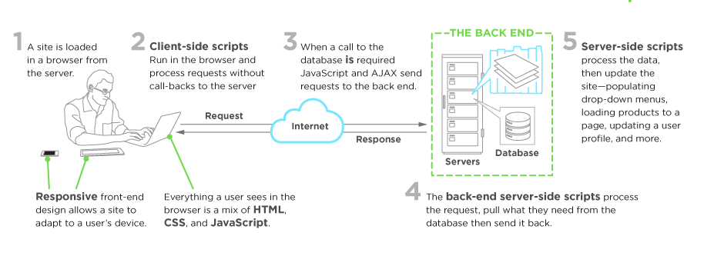
How Web Works

Slide 5
CSS Frameworks, Libraries, and Preprocessors
Bootstrap
Tailwind CSS
Bulma
Materialize
Semantic UI

Slide 6
JavaScript libraries and frameworks
React: React is a popular JavaScript library for building user interfaces, developed by Facebook.
Angular: Angular is a popular JavaScript framework for building complex, large-scale web applications, developed by Google.
Vue.js: Vue.js is a progressive JavaScript framework for building user interfaces, designed to be flexible and easy to learn.
jQuery: jQuery is a popular JavaScript library that simplifies HTML document traversal, event handling, and animation.
Backbone.js: Backbone.js is a lightweight JavaScript framework that provides a simple and flexible structure for building web applications.
D3.js: D3.js is a JavaScript library for data visualization, which allows developers to create interactive and dynamic data visualizations.

Slide 7
What is DOM?
DOM stands for Document Object Model
It is a programming interface for web documents
The DOM represents the page so that programs can change the document structure, style, and content
The DOM provides a way to access and manipulate HTML elements on a web page
Developers can use JavaScript to change the content, style, and structure of the page
With the DOM, developers can create dynamic web applications that respond to user input

Slide 8
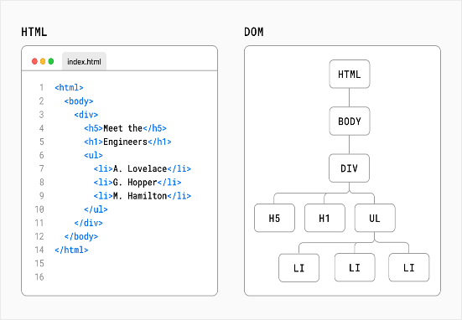
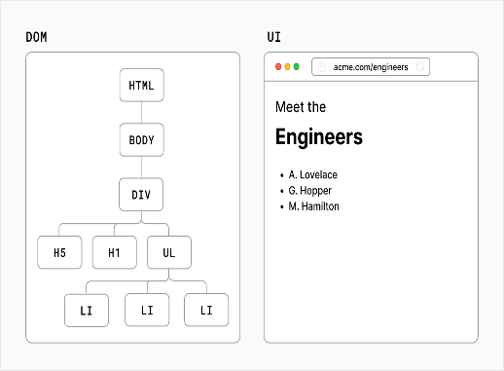
Rendering User Interfaces

Slide 9
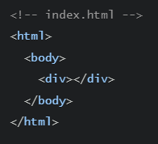
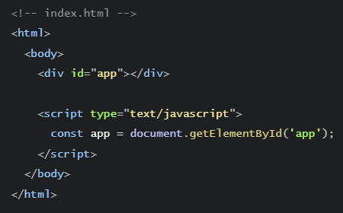
JavaScript and DOM Methods
Plain HTML
Add JavaScript to HTML
Example given here: https://www.w3schools.com/js/tryit.asp?filename=tryjs_dom_method

Slide 10
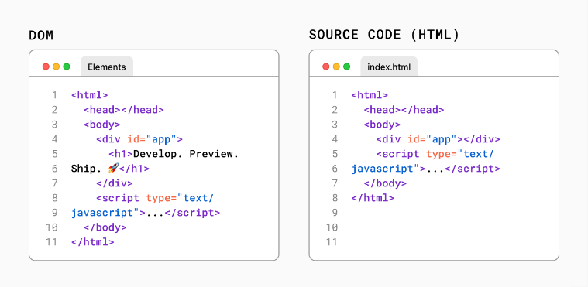
HTML vs the DOM

Slide 11
References
W3Schools Online Web Tutorials, URL: http://www.w3schools.com
Next.js, URL: https://nextjs.org/
Mozilla Developer Networks, URL: https://developer.mozilla.org/

Slide 12
Thank You!

